Slide 1
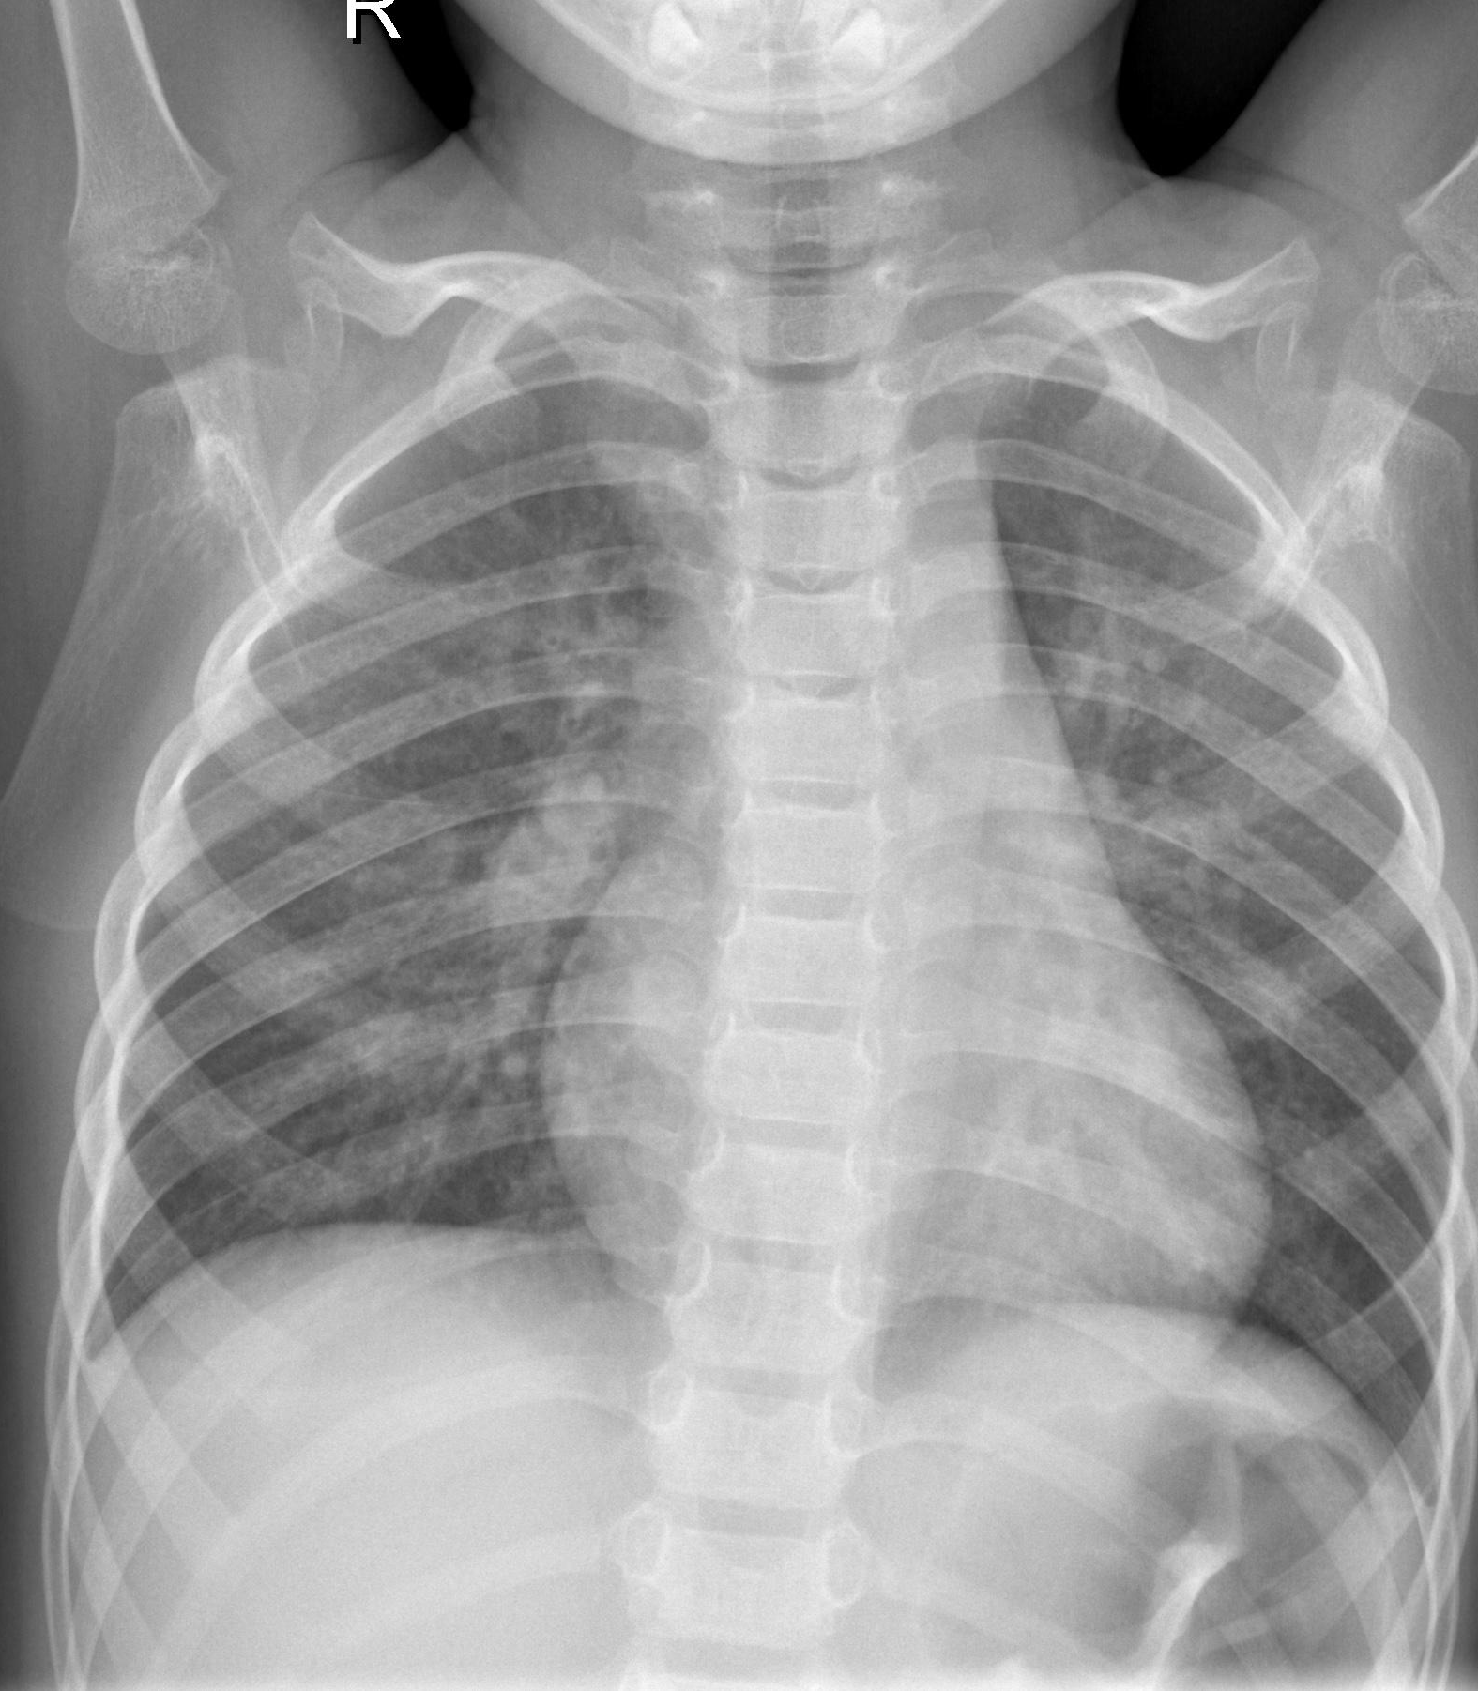
Pneumonia Detection Project Presentation
APS360 Group 29
Ariana Lin, Haobo Wang, Rosalind Wang, Muchen Liu

Slide 2
Table of Content
Problem
Data and Data Processing
Model
Demonstration
Quantitative and Qualitative Results
Discussion and Takeaways

Slide 3
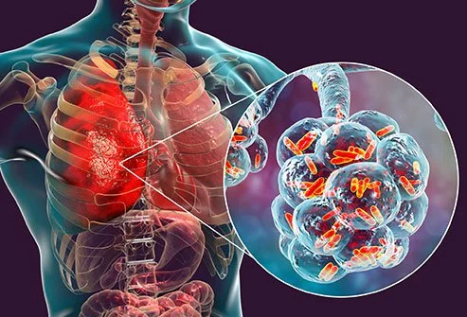
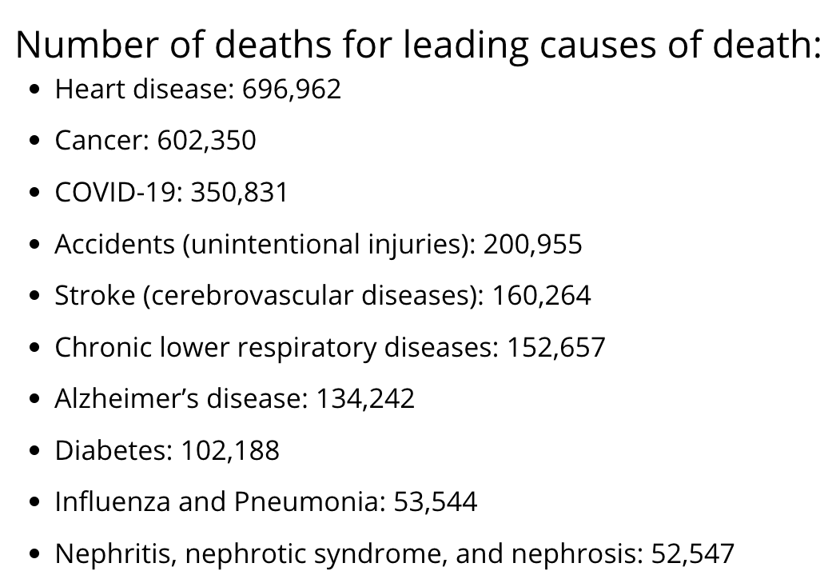
Problem Identified – Pneumonia
https://www.cdc.gov/nchs/fastats/deaths.htm
https://www.emedicinehealth.com/bacterial_pneumonia/article_em.htm
Notes:
https://www.emedicinehealth.com/bacterial_pneumonia/article_em.htm
https://www.cdc.gov/nchs/fastats/deaths.htm

Slide 4
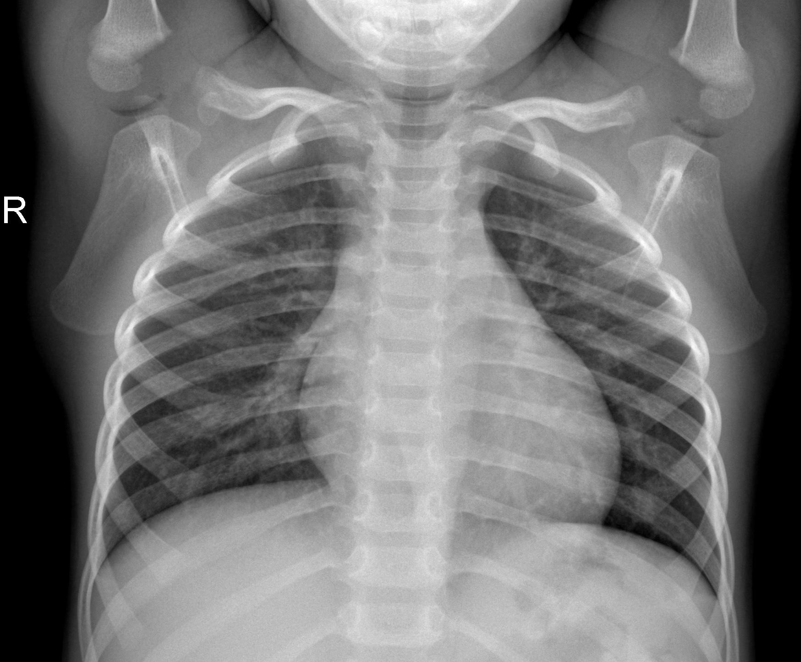
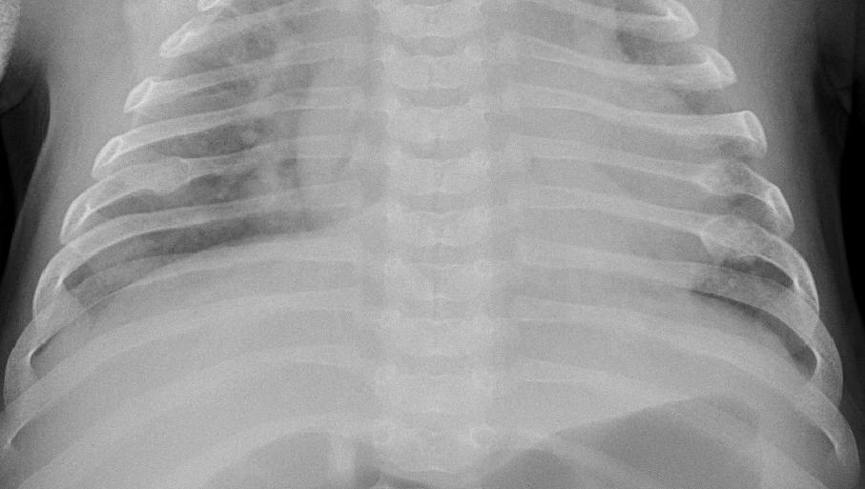
Pneumonia Detection
Normal lung X-ray image
Lung X-ray image with pneumonia
https://www.kaggle.com/datasets/paultimothymooney/chest-xray-pneumonia
Notes:
https://www.kaggle.com/datasets/paultimothymooney/chest-xray-pneumonia

Slide 5
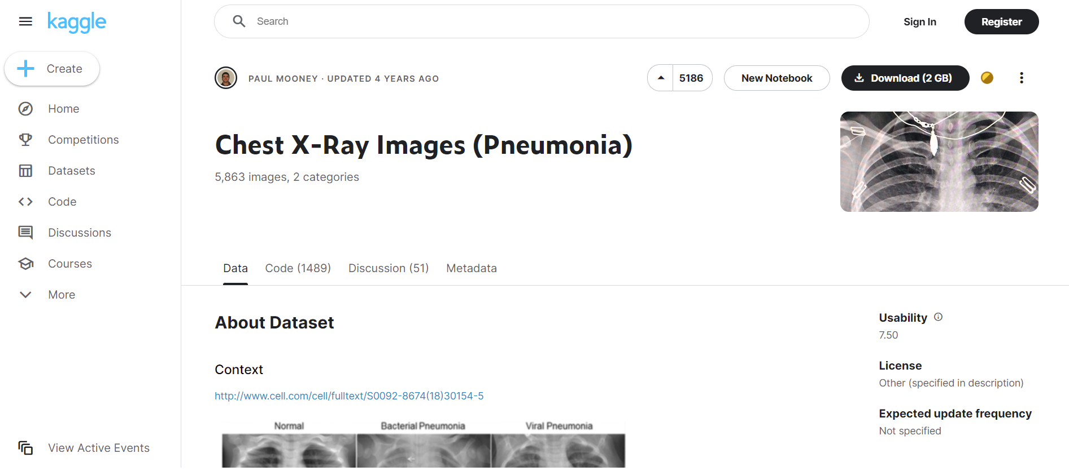
Data
The data of chest X-Ray images of pneumonia is collected from patients aged 1 to 5 years from Guangzhou Women's and Children's Medical Center by accessing the public data platform, Kaggle, published by PAUL MOONEY in 2018.(https://www.kaggle.com/datasets/paultimothymooney/chest-xray-pneumonia )
Notes:
https://www.kaggle.com/datasets/paultimothymooney/chest-xray-pneumonia

Slide 6
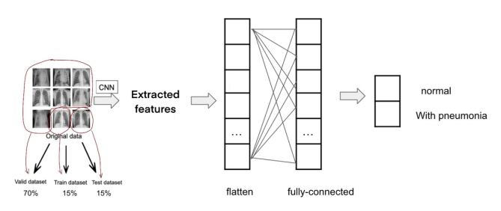
Data Processing
1583 normal and 4273 pneumonia
70% training set
15% validation set
15% testing set
1500 *1400 –resized–> 100*100
Label ‘normal’ to 0 and ‘pneumonia’ to 1
CNN + ANN

Slide 7
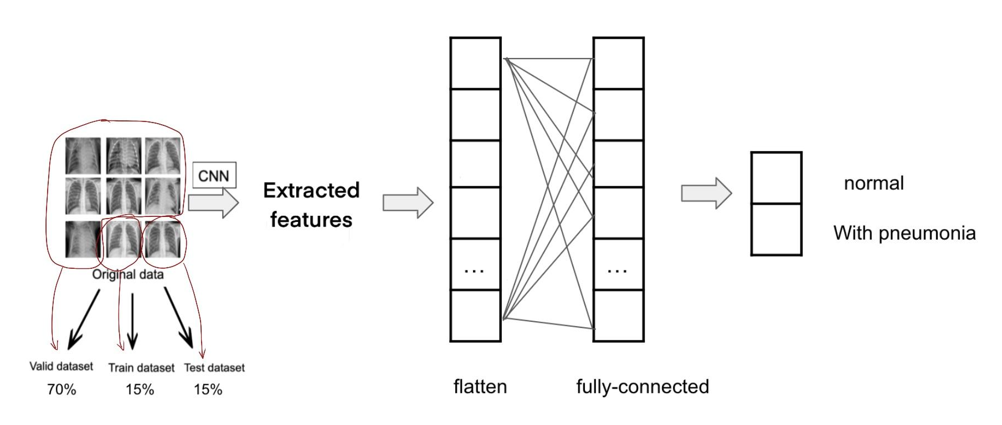
Model
The basic structure of the
model is Convolutional
Neuron Network(CNN)
Connected with Artificial
Neuron Network(ANN)

Slide 8
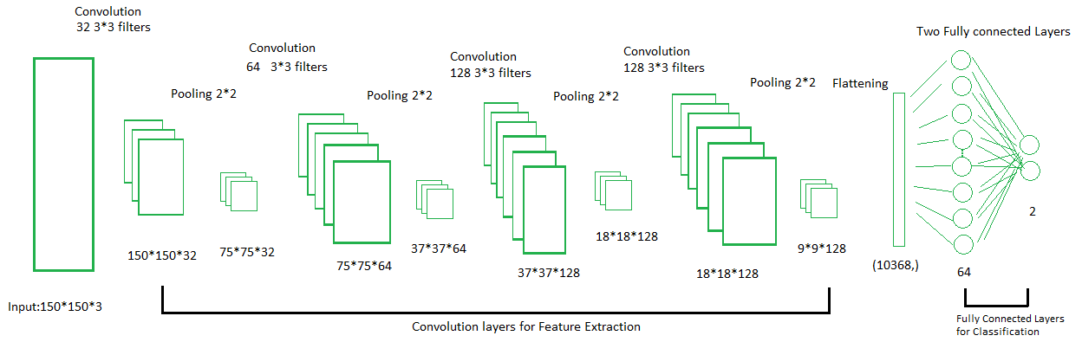
Model
The final model our team created consists
Four Convolutional layers, these layers are connected with Max Pooling layers.
Two fully connected Layers.

Slide 9
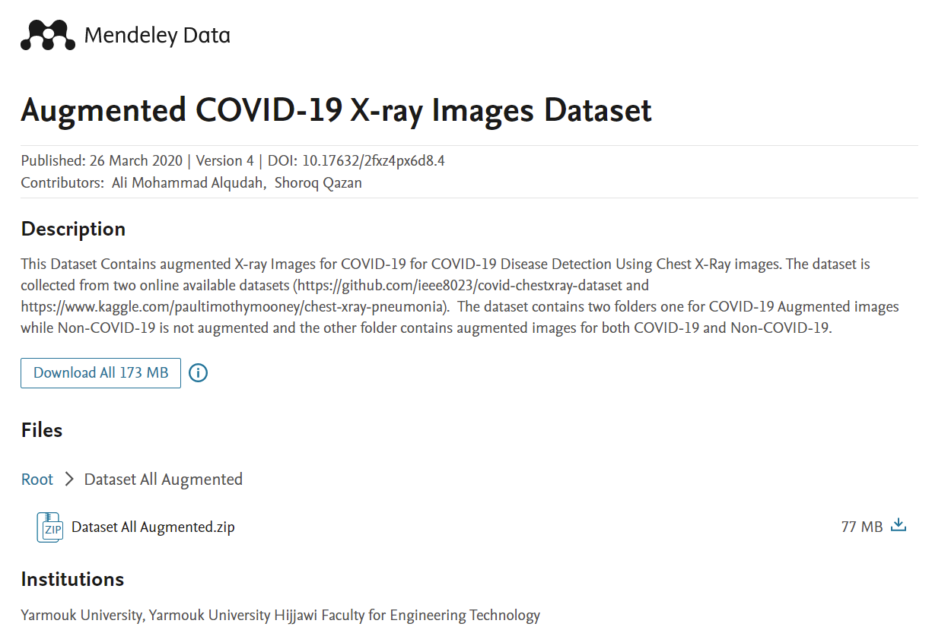
Demonstration
Never tested data from Mendeley Data
332 normal images
483 pneumonia images
73% accuracy
https://data.mendeley.com/datasets/2fxz4px6d8/4
Notes:
https://data.mendeley.com/datasets/2fxz4px6d8/4

Slide 10
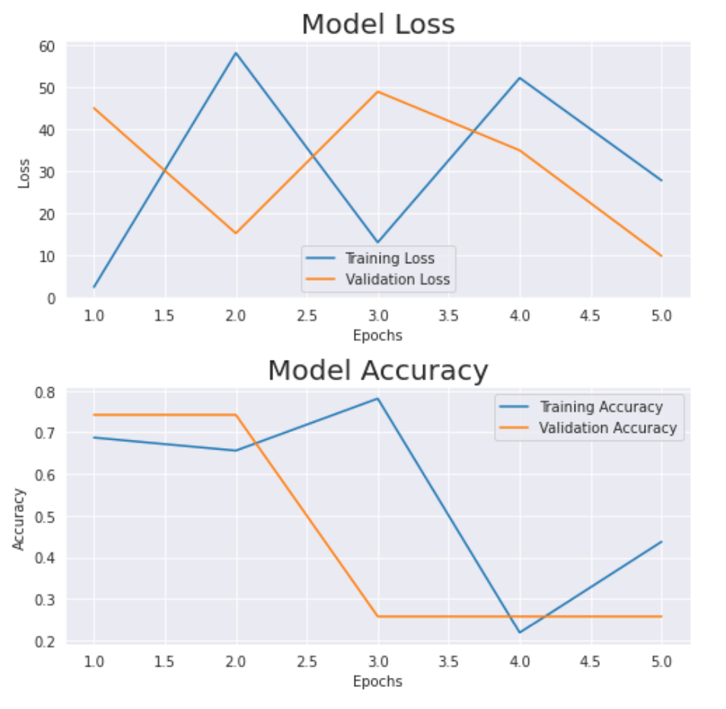
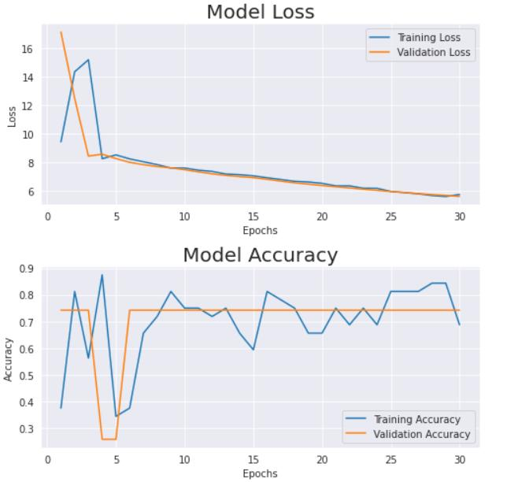
Result
Initial Model
Final Model
Epoch: 5/5
Test Accuracy: 0.2691
Test Error: 9.8022
Epoch: 30/30
Training Accuracy: 0.7045
Training Loss: 5.2595
Validation Accuracy:0.7422
Validation Loss: 5.1737
Epoch: 30/30
Test Accuracy: 0.7309
Test Loss: 4.95

Slide 11
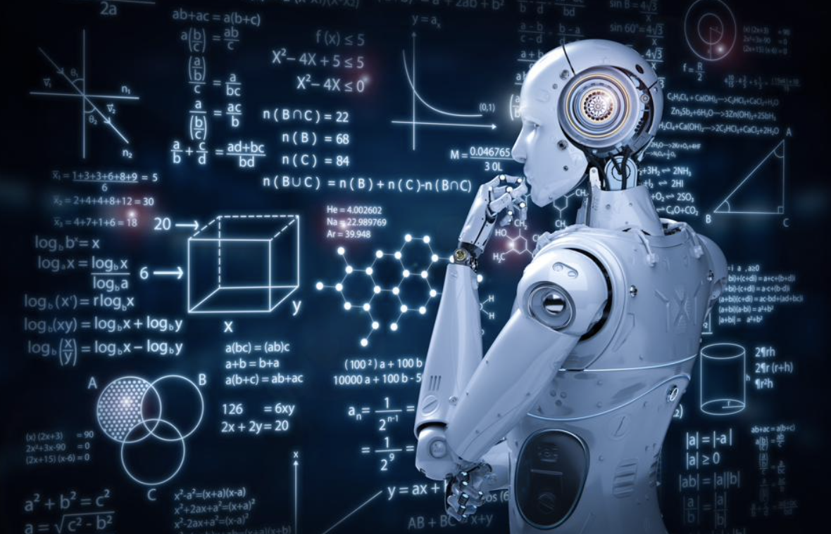
Takeaways
What we get about machine learning from doing this project.
https://www.forbes.com/sites/kalevleetaru/2019/01/15/why-machine-learning-needs-semantics-not-just-statistics/?sh=7c60c70a77b5
Notes:
https://www.forbes.com/sites/kalevleetaru/2019/01/15/why-machine-learning-needs-semantics-not-just-statistics/?sh=7c60c70a77b5

Slide 12
Thanks For Listening!

